Slide 1
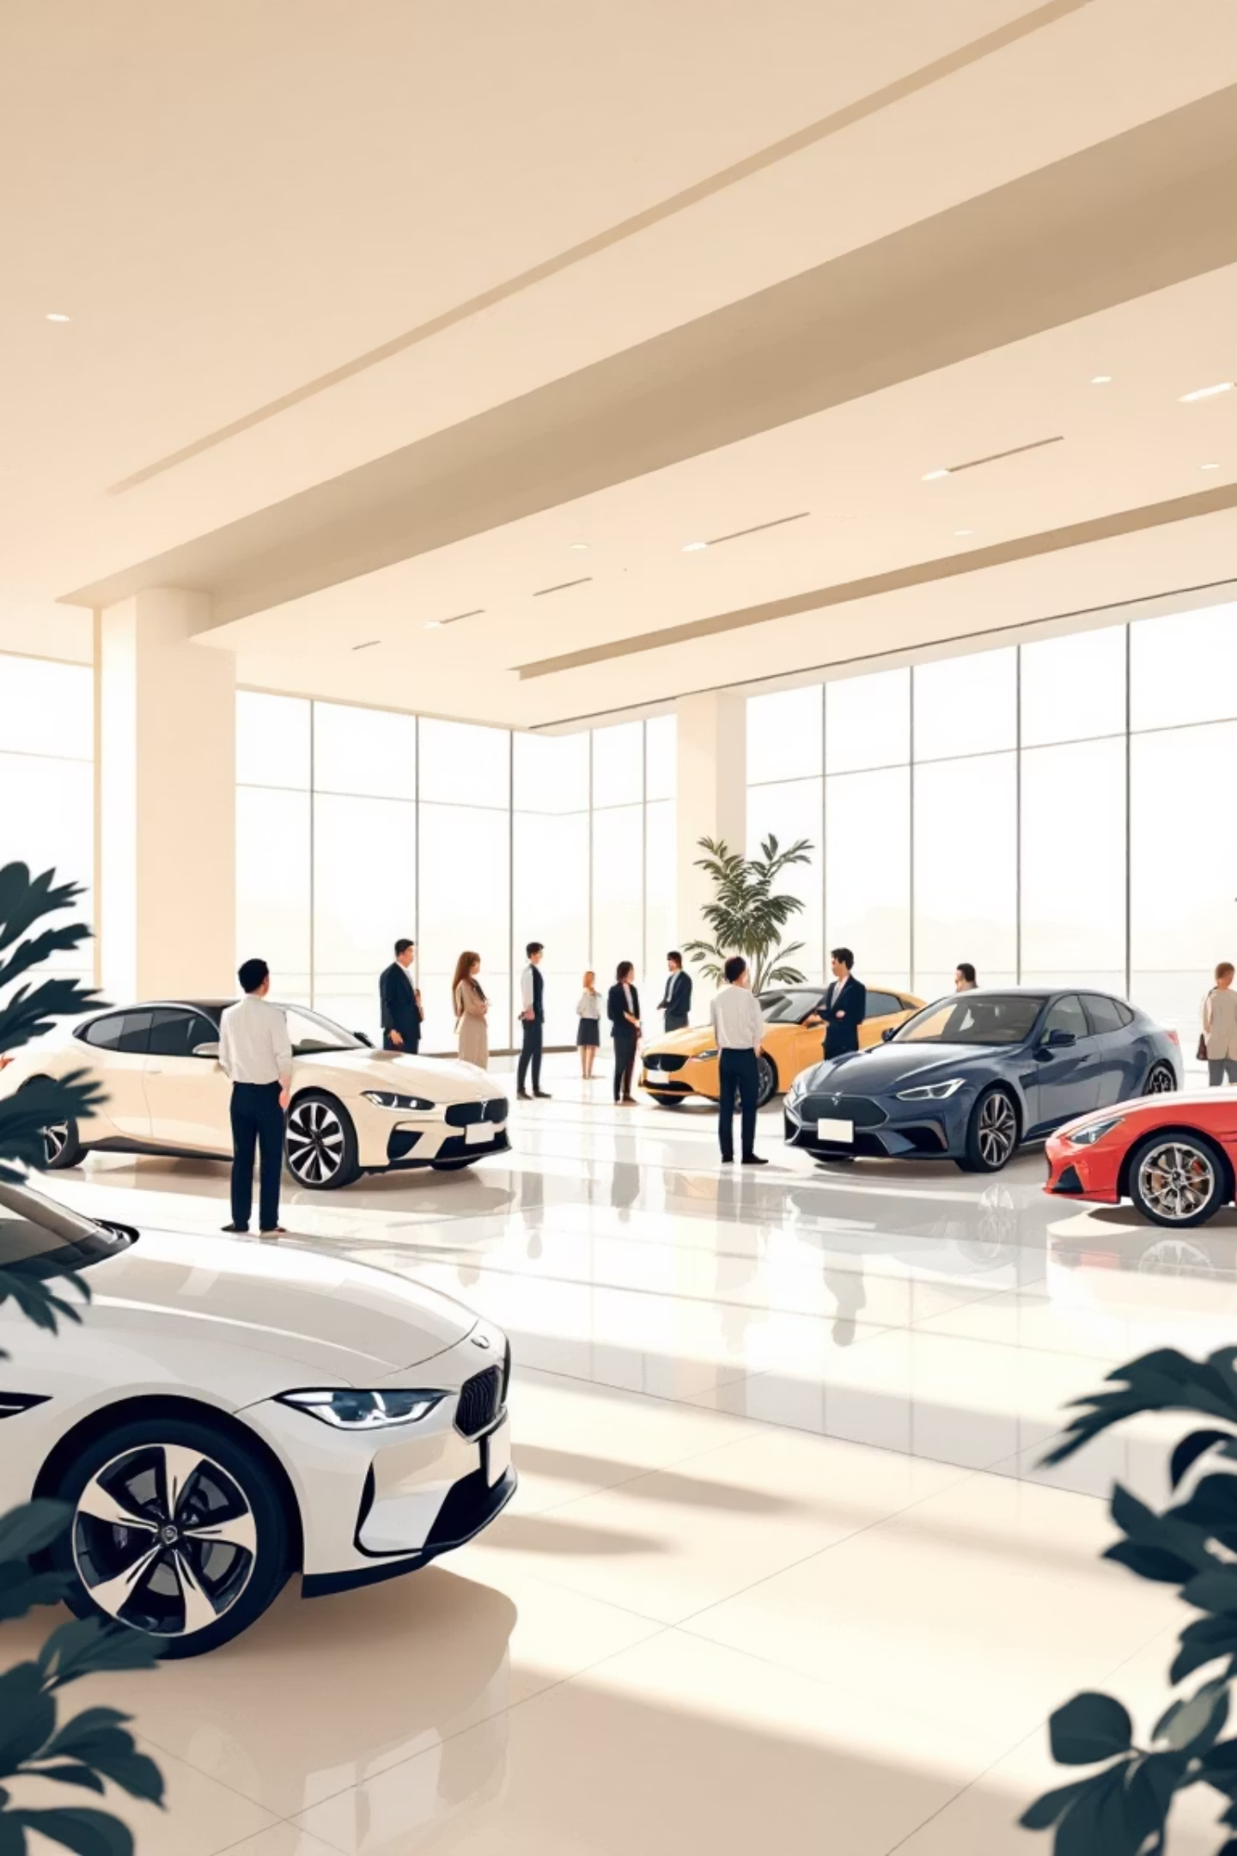
CarDekho Sales Performance Analysis
Unlocking Growth Opportunities in the Automotive Market

Slide 2
EXECUTIVE SUMMARY
Strategic Insights on Cardekho Sales Data
This report analyzes CarDekho’s sales data from 1992–2020, offering a detailed look into market trends, customer preferences, and brand performance to identify strategic opportunities.
1
2
Sales Trends
Market Segmentation
Analyzes historical sales growth and peak performance periods.
Examines price segments, fuel types, and transmission preferences.
3
4
Brand Dynamics
Ownership Patterns
Identifies top-selling brands and their market positions.
Breaks down sales by owner type and mileage for used cars.

Slide 3

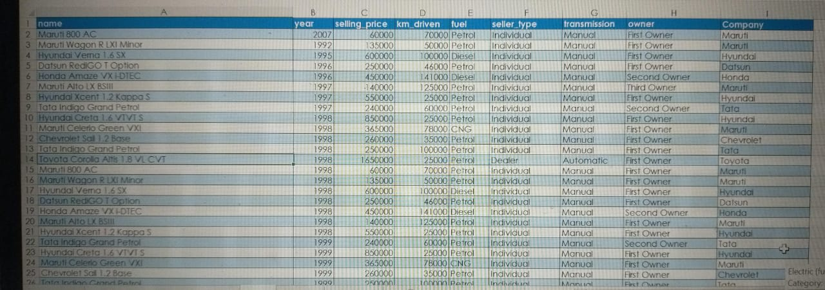
Data Cleaning & Preparation
Our analysis began with rigorous data cleaning to ensure accuracy and reliability.
Raw Data Sourcing: Acquired data from Kaggle, providing a comprehensive dataset for analysis.
Duplicate Removal: Eliminated redundant entries to maintain data integrity.
Structure Uniformity: Applied TRIM functions to standardize text fields and ensure consistent formatting.
Feature Engineering: Extracted 'Company' names from 'Car Model' for enhanced brand-specific insights.
Table Design: Implemented a clear and organized table design for improved readability and analysis.

Slide 4
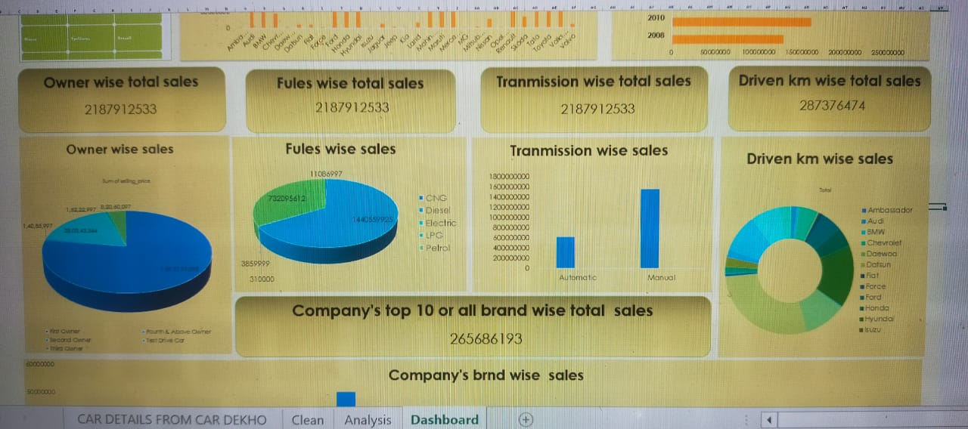



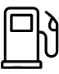

Key Performance Indicator (KPI) Insights
Understanding the core metrics driving CarDekho's sales performance.
Top-Selling Brands
Price Segment Performance
Leaders: Maruti Suzuki, Hyundai, Honda. These major players dominate the market, while smaller brands maintain niche positions.
Volume Leader: ₹4–8 lakh bracket. Premium segment (>₹15 lakh) has lower volume but higher profitability per unit.
Transmission Share
Fuel Distribution
Manual dominates, but automatic adoption is in its early growth phase, indicating future shifts.
Petrol remains dominant, diesel holds a considerable share. CNG/LPG have low presence but significant growth potential.

Slide 5
Total Sales Overview (1992-2020)
Analyzing the historical trajectory of CarDekho's sales volume.
Total Sales Volume: 1,390,076,860 units over the period. Sales grew steadily, with a rapid growth phase in the 2010s, peaking at 7.1 million units in the highest-selling year.

Slide 6
Ownership Type Distribution
Understanding the market demand for new vs. pre-owned vehicles.
First Owner: 77% of total sales, indicating a strong preference for new or near-new vehicles.
Second Owner: Approximately 17% of the market, representing a significant pre-owned segment.
Third & Above: Combined 6%, highlighting a smaller but present niche for older used cars.
This distribution underscores robust market demand for new or first-owner resale vehicles, suggesting opportunities in both segments.
First Owner
Second Owner
Third & Above

Slide 7
Fuel & Transmission Preferences
Decoding consumer choices in power and driving experience.
Sales by Fuel Type
Sales by Transmission
Manual
Automatic
Petrol dominates the market. Diesel remains a significant contributor. CNG & LPG have minor shares, but represent a growing segment of eco-conscious buyers.
Manual transmission is the majority preference. Automatic is a smaller but steadily growing segment, particularly appealing in urban markets.

Slide 8
Key Business Observations
Strong Brand Loyalty
Maruti, Hyundai, and Honda consistently hold top positions, showcasing enduring brand trust.
Price Sensitivity
Majority of buyers gravitate towards mid-range cars, highlighting the importance of competitive pricing.
Fuel Preference Shift
Petrol maintains its stronghold, but diesel's market share is anticipated to decline due to evolving emission norms.
Urban Market Opportunity
Automatic cars are gaining traction in cities, signaling a growing demand for convenience in congested environments.
Low Mileage Resale Value
Used cars with fewer kilometers driven attract premium buyers, emphasizing the value of well-maintained vehicles.

Slide 9
Strategic Recommendations
Leveraging insights for future growth.
Target Top Brands
Boost Automatic Offerings
Expand Alternative Fuels
Focus marketing and partnerships on market leaders (Maruti, Hyundai, Honda) to maximize reach and sales.
Increase city-focused campaigns for automatic models, capitalizing on urban market trends.
Introduce and promote CNG, hybrid, and EV options to capture the eco-friendly buyer segment and align with future policies.
Highlight Low Mileage Cars
Segmented Pricing
Maintain dominance in the ₹4–8 lakh segment while strategically building a niche in the luxury car market.
Leverage mileage as a key selling point in the used car market to attract premium buyers and command better prices.

Slide 10

Thank You
We are committed to driving sales excellence and customer satisfaction.
Questions?

